Slide 1








Access our Github here!
LUNA
By Team Hex

Slide 2
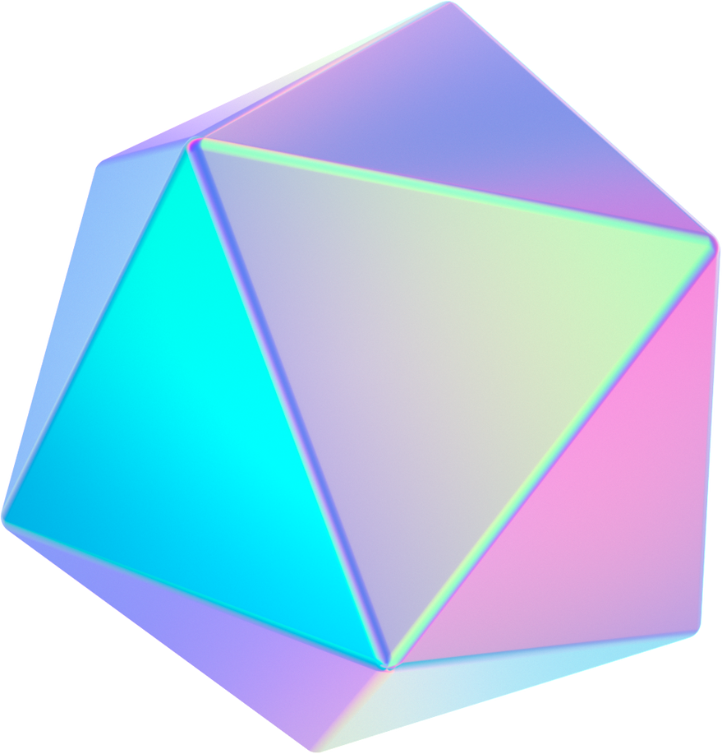


What is LUNA
LUNA stands for (Logical User-Friendly Navigation Assistant). It is a new way to interact with your pc with your voice. Using it's various commands, we can access different parts of our PC using different functions.

Slide 3
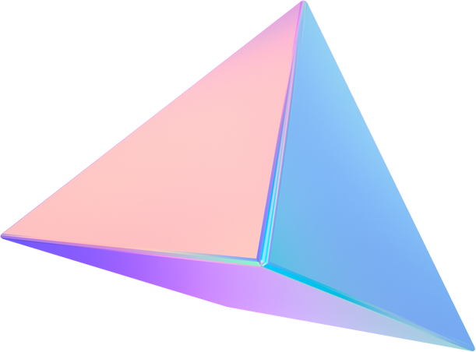

Language
We used 'Python' language to develop this project. We used various other APIs to integrate various experiences into the application.

Slide 4



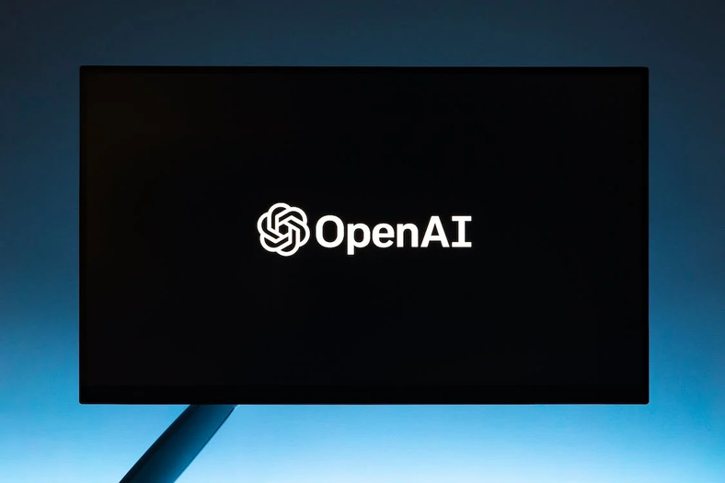
What can LUNA do?
Read the News
Play Music
Use GPT-3
LUNA can read the news and display the top 5 news happening in INDIA, further, we can ask it to display the news across the globe as well
LUNA will also be able to play music using the Spotify API to play different music that you like!
LUNA uses GPT-3 to give answers to various questions you ask. Try asking it some random questions and see it work!

Slide 5


Other Functions
Movie Reviews
Weather
Web-Functions
Luna can give you the reviews of your favourite movies!
LUNA will be able to show the current weather based on your city!
It can perform various different web functions and open different pages!

Slide 6



Even more functions!
Reminders
Wikipedia
Date & Time

Slide 7

Advantages
LUNA allows you to get more done faster, thanks to its powerful navigation, productivity, and communication features.
LUNA can be customized to suit your preferences and needs, ensuring that you get the most out of your virtual assistant.
With LUNA, anyone can benefit from the power of advanced AI and machine learning technologies, regardless of their technical expertise or knowledge.

Slide 8
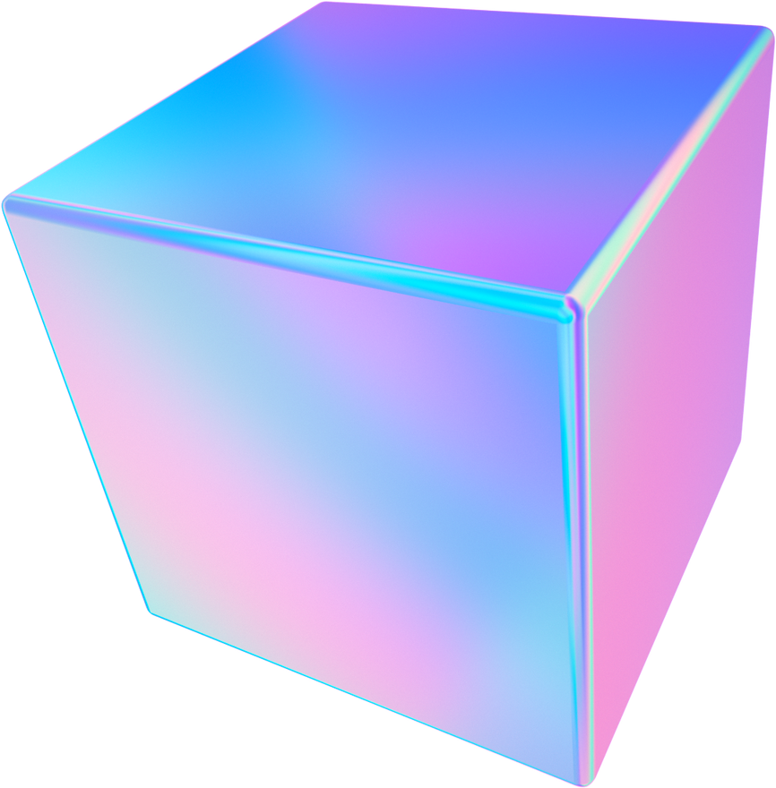

With good data and the right technology, people and institutions today can still solve hard problems and change the world for the better.

Slide 9

Team HEX
Thank You
Keshav Memorial Institute of Technology
Narayanguda, Hyderabad

